Slide 1

Redesigned Partnerships as a Result of a Redesigned Educator Preparation Program
TECSCU-TRG, October 8th, 2018

Slide 2
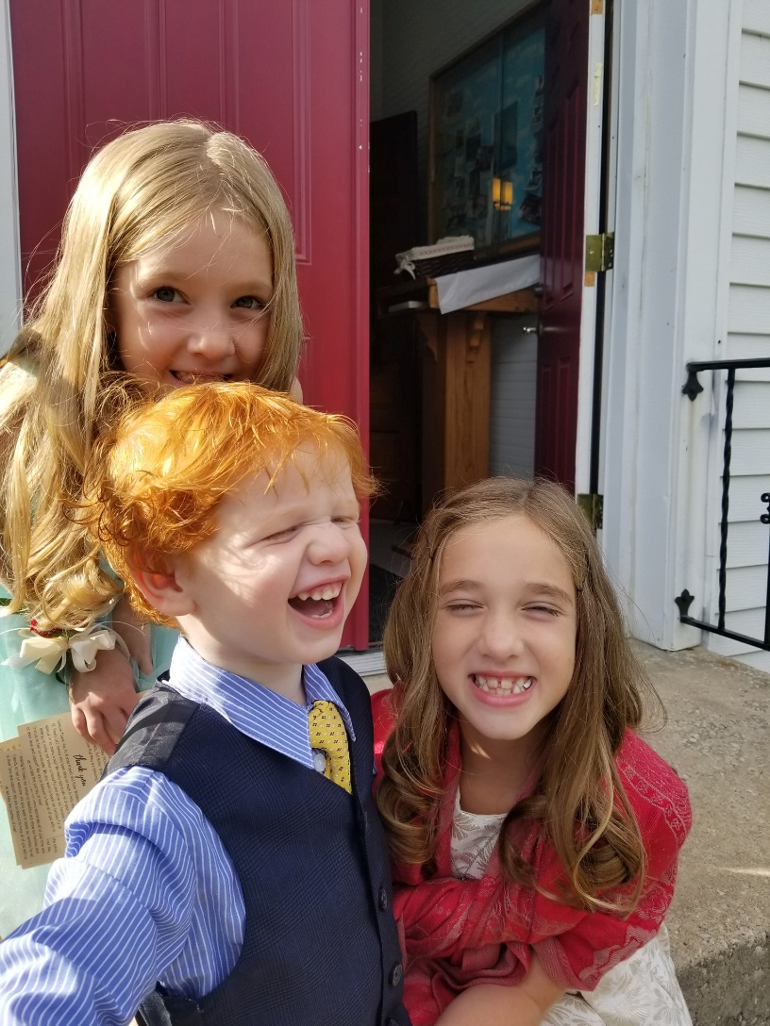
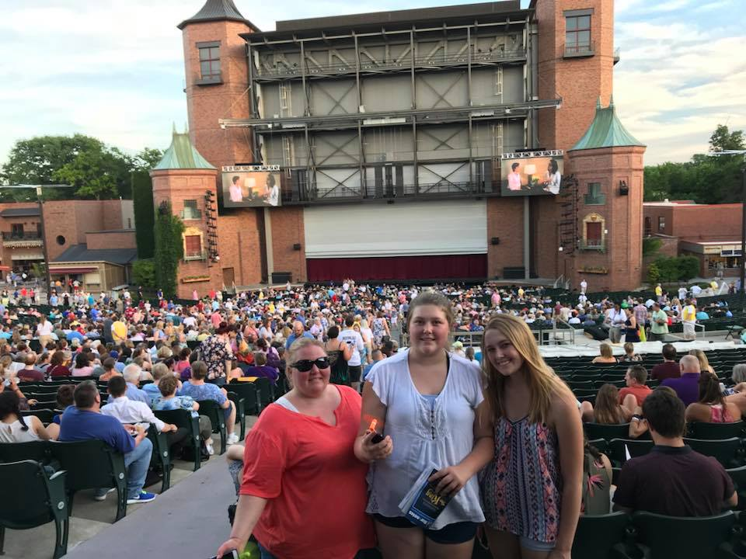
Who are we?

Slide 3
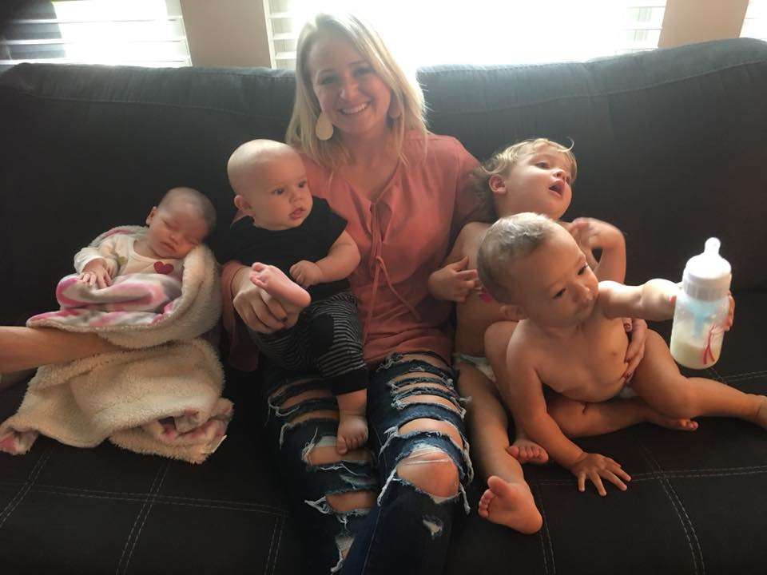
Who are we?

Slide 4

Our team
Dr. Linda Gray-Smith, Assistant Professor and former school District HR leader
Dr. Sue Wood, Assistant Dean and Curricular Leader
Dr. Greg Rich, Clinical Field Experience Coordinator and former district administrator
Dr. Everett Singleton, Assistant Professor and former Principal for Youth Offenders
Dr. Tim Wall, Dean and Director of Teacher Ed.
Dr. Travis Dimmitt, Assistant Professor
Dr. Joseph Haughey, Assistant Professor

Slide 5

Presentation overview
Situate our redesign & partnerships in a broad context:
  Rural location
  Wisdom of the field: State Policy, National accreditation Renaissance Group
Describe an institutional curricular redesign
Share drivers and factors leading to redesign
  Political, economic, policy-maker-led
Share the structures and processes- clinical practice
Describe the development of new partnerships
  Districts and cross-campus connections
Explain the impact of redesign
  Evidence from student learning

Slide 6
Northwest Education Redesign, 2014-2018: from roots to fruits
Faculty Team formed, begins collaborative curricular overhaul
Spark of Curricular Revision- Dr. Wood leads with a dream
A visual representation of redesign process
Faculty research: clinical practice, partnerships, and instructional practices
Dean’s Challenge: “rebuild desired program from scratch”
Advisory Council relied upon for practical wisdom, research, and partnership
MO State ed. Department changes cert rules (2014)
Redesigned curriculum launched in 2017

Slide 7
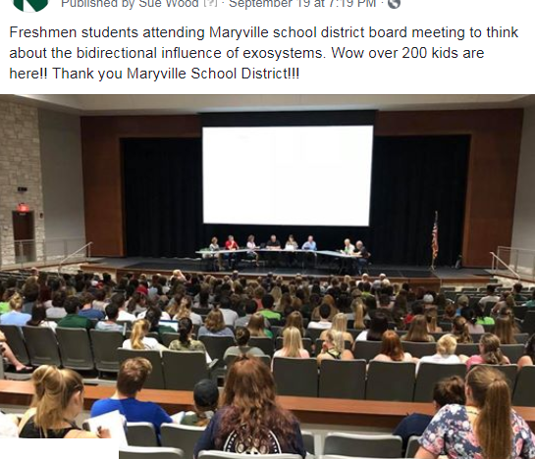

Slide 8
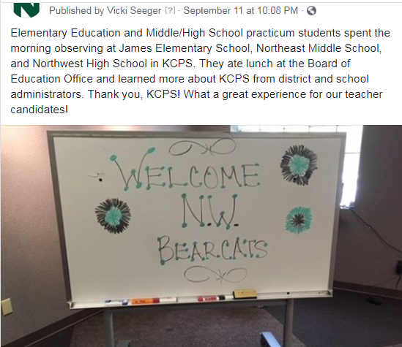

Slide 9
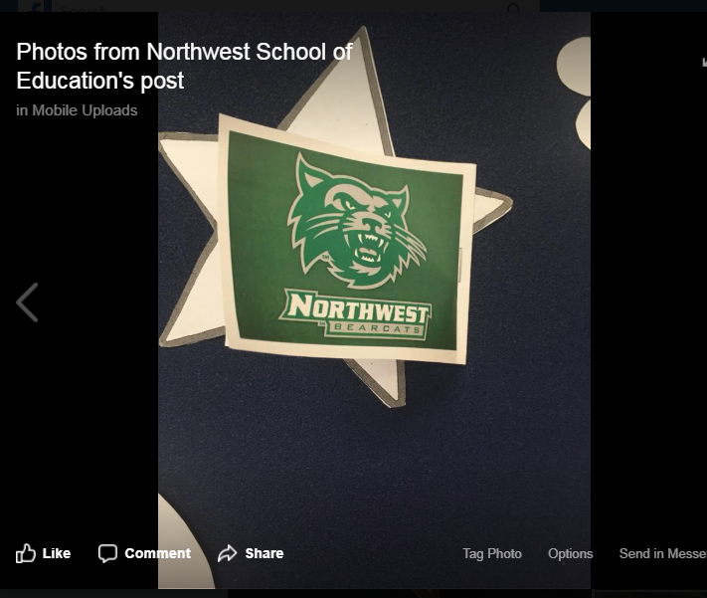

Slide 10
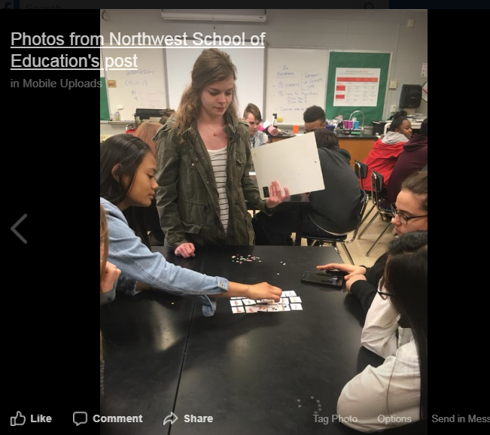

Slide 11
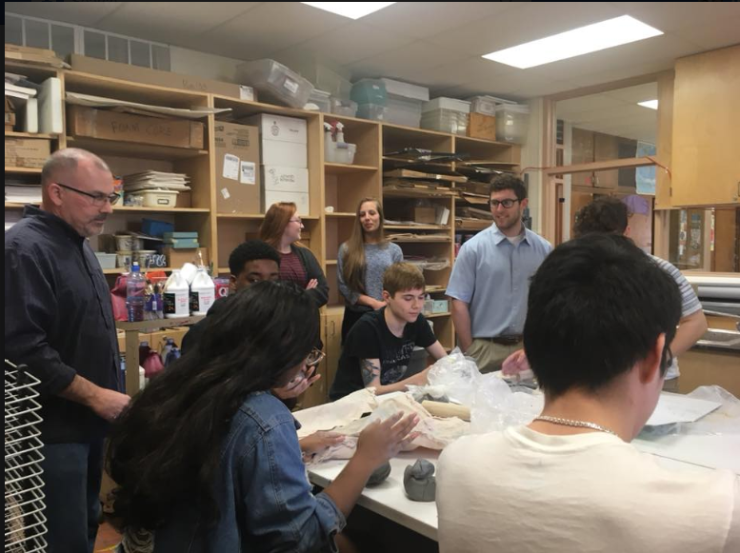

Slide 12
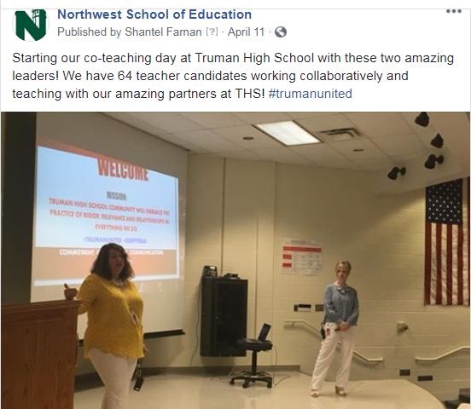

Slide 13
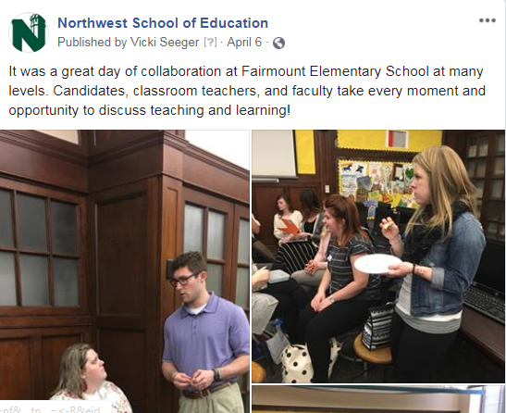

Slide 14
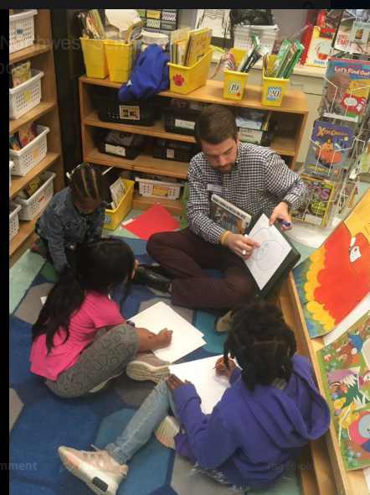

Slide 15
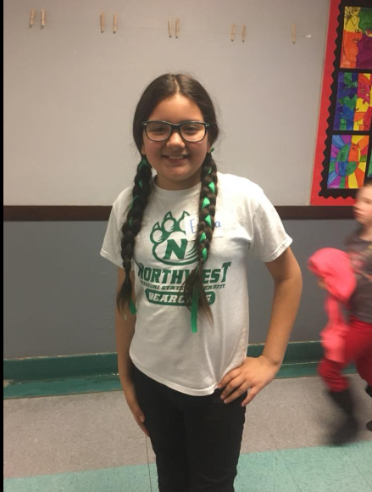

Slide 16
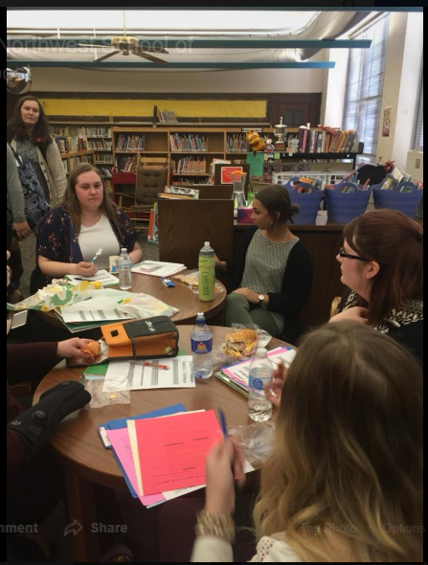

Slide 17
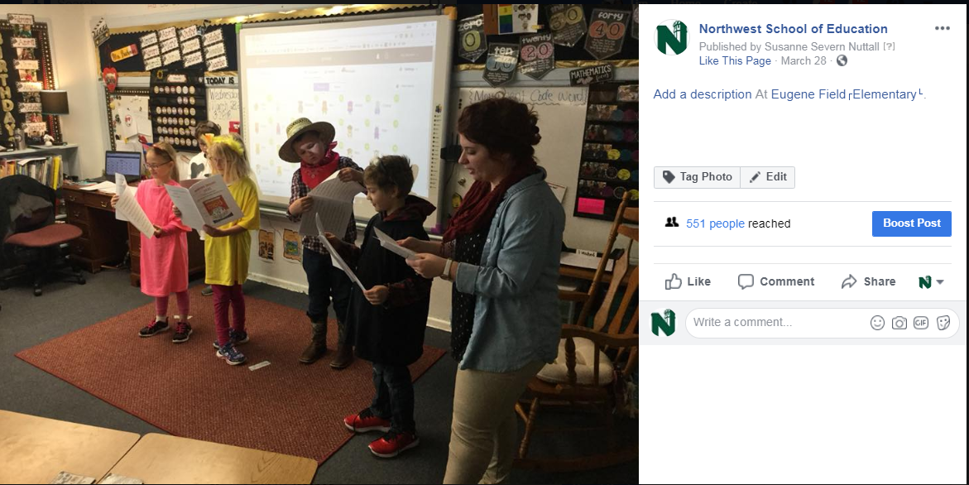

Slide 18
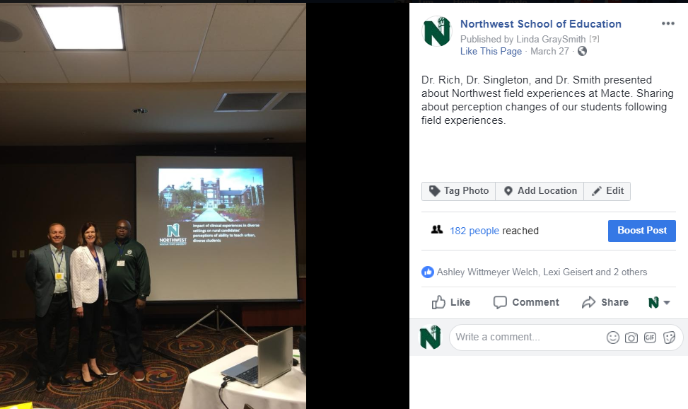

Slide 19
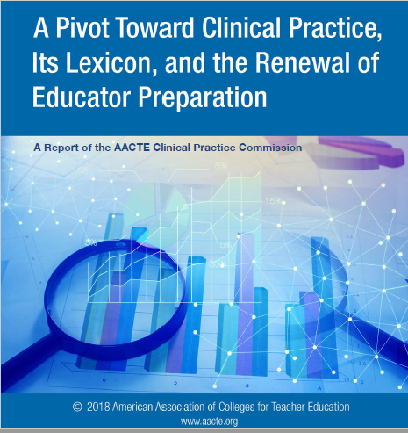
AACTE – suggestions and recommendations

Slide 20
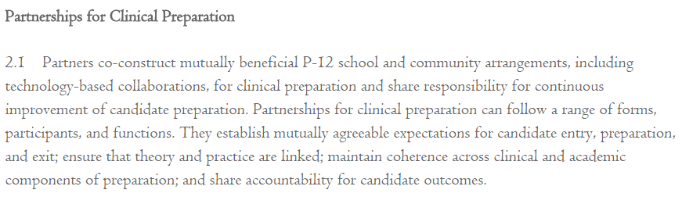
CAEP standard 2.1:
Co-development of Clinical Partnerships

Slide 21
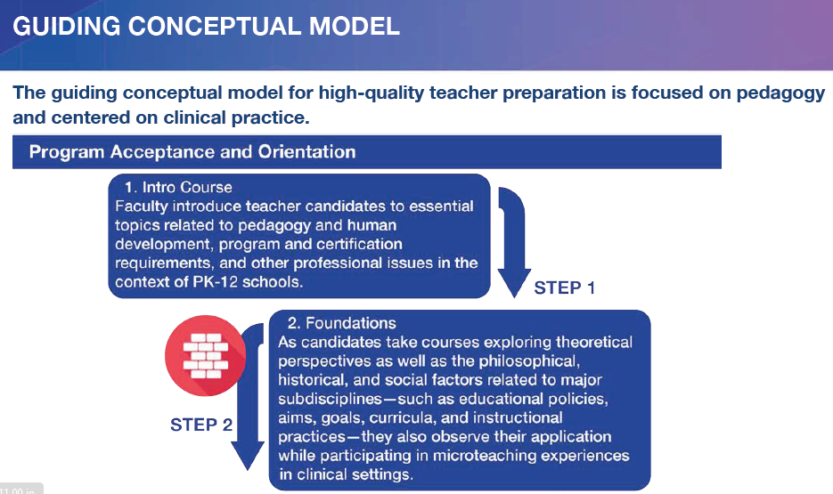

Slide 22
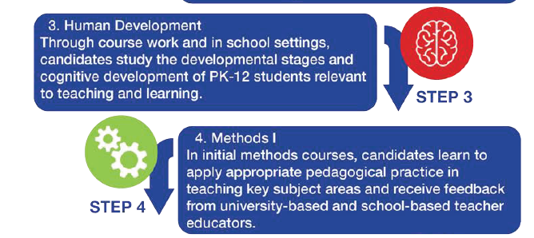

Slide 23
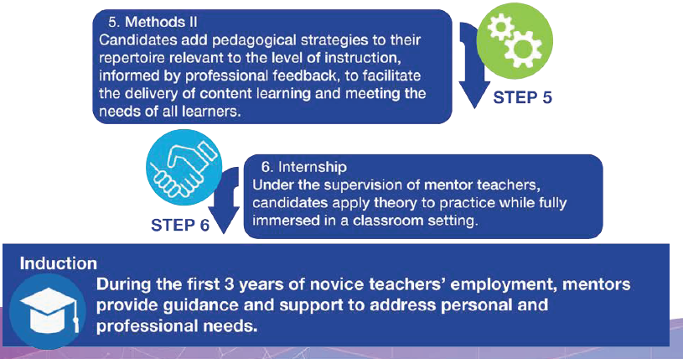

Slide 24

2014- Department of Elementary and Secondary Education- Compendium changes
2014- total credits declined, per state mandate
Challenge: How to have it all? Pedagogy, content, clinical practice, efficiency?
total

Slide 25
2014- Former Dean- issues a fundamental challenge to education staff and faculty
Faculty leader emerges. Begins sharing her vision and sparks change.
Dr. Wood will describe the spark and processes:
“How did Redesign take shape?”
total

Slide 26
Shoulder partner activity- Imagineering
Turn to a colleague and talk about what it would look like in your program if the this challenge were posed to you at your institution:
“If you could redesign your program, what would it look like?”

Slide 27
What principles from the Renaissance group/ national standards impacted Redesign?
“The education of teachers incorporates extensive and sequenced field and clinical experiences in various settings with effective supervision.” TRGP4
“The education of teachers is an all-campus responsibility undertaken in collaboration with PK-12 school personnel.” TRGP1
total
“The continuing professional development of teachers is the shared responsibility of the individual, of the university faculty, and other professional educators” TRGP8
“Pre-service teachers and faculty members reflect our pluralistic society and are committed to the education of all students in diverse schools.” TRGP&

Slide 28
The role of the Advisory Council in Education Redesign
Question: “What did our Education Advisory Council ask from Northwest’s School of Education?”
total
Driving Theories behind Redesign
Bronfenbrenner (1979)
Dweck’s Growth Mindset (2006)
Gay’s Culturally-Responsive Teaching (2000)
Wiggins & McTighe (2005)
Chappuis & Stiggins (2017)

Slide 29
Redesign: Phases and Modules
What is involved in Phase I?
What is the meaning of Phase I?
II?
III?
total
What is involved in Phase II?
What is involved in Phase III?

Slide 30
Next, some visuals about our phases
Here is what we shared with our colleagues to approve the curriculum and gain buy-in
Tell story: deleting the old program

Slide 31
 | Phase I All Certification Tracks
Semester 1 | Semester 2 | Semester 3
Module 1: Ecology of Teaching and Learning 7 weeks Teaching from a diverse perspective Factors that influence teaching and learning Communication and collaboration with families’ Confidentiality Communication and collaboration with co-workers/colleagues Collaborative data processes Culturally responsive teaching Transformative experiences with communities and family Identifying bias and understanding Professional development throughout the career—life-long learning Co teaching processes Dispositions (MEP) Why do you want to be a teacher? Personal data notebook Field experience at all levels | Module 3: Introduction to Curriculum and Instruction 7 weeks Academic vocabulary of curriculum and instruction Locating state and national standards Teaching and critical thinking (including DOK) Student Engagement strategies Instructional resources that lead to increased critical thinking and problem solving Differentiated instruction (Content, Process, Product) Backward design (Wiggins and McTighe) Purpose and models of lesson planning Co-teaching What is a culturally responsive curriculum framework The field experience for this class would be a beginning teaching experience. A video could be made of them teaching and be placed in their data notebook . Anecdotal records | Module 5: Inclusive Classrooms and Positive Learning Environments 7 weeks Introduce standards-based interdisciplinary units as a way to meet the needs of all learners and promote deeper understanding. Student engagement strategies Classroom management Management of time, space, transitions, for positive environments Opening day experiences Prevention: Proactive not reactive Procedure/Procedure/Procedure Emotional Intelligence Definition of Inclusion (Strengths based vs deficit based) Mental health issues and the inclusive classroom The field experience in this class would be the observation of promising practices in diverse settings.
Module 2: Developmental Foundations of Learning 7 weeks Developmental and learning theories Using developmental theories and stages to plan instruction (developmentally appropriate practices) Goal setting Theories that support teaching for diversity Connecting instruction to family, prior experiences, culture and community This class will include a beginning field experience, “The Art of Noticing” | Module 4: Principles of Assessment 7 weeks Formal and informal Cyclical relationship between assessment and instruction Self and peer assessment—students setting their own goals Collaborative data analysis at department/grade level/school level to improve curriculum and instruction Ethical and Legal implications Communication of student records Summative and formative assessment Universal Design Co-planning/co-teaching (faculty modeling the co-teaching) Goal setting for teachers as learners and for learners The field experience for this class could be the analysis of anecdotal records collected in preceding class. | Module 6: Teaching As Communication 7 weeks Oral Communication (Partner with Gen. Ed. course) Verbal and Non-verbal communication Social-cultural differences in communication styles How to facilitate communication, learner expression Appropriate selection of media tools to enhance teaching and learning How to Listen Teacher Website/Blogs Adjusting communication style to the listener Partner with international student/school experiences/communication/learning styles Written communication Professional communication Collaboration Culturally responsive forms of communication Field Experience

Slide 32
PHASE II:
Elementary Certification Track
Semester 4 | Semester 5 | Semester 6
Content | Content | Content
Module 1: Designing Integrated Curriculum (Part I) 2 weeks | Module 5 :Designing Integrated Curriculum (Part II) 2 weeks | Module 9: Designing intervention/ assessment/RtI/Universal Design including ELL strategies 2 weeks
Module 2: Literacy in the Elementary School including ideas for art, music and PE integration (7 weeks: co- taught) | Module 6: Science in the Elementary School including ideas for literacy, art, music and PE integration (6 weeks: co-taught) | Module 10: Theory and techniques of Literacy Assessment and Intervention (4 weeks)
Module 3: Social Studies in the Elementary School including art, music, PE integration (4 weeks: co-taught) | Module 7: Math in the Elementary School including art, music, PE integration (6 weeks: co-taught) | Module 11: Theory and techniques of Math Assessment and Intervention (4 weeks)
Module 4: Delivering Integrated Curriculum (Part I) Putting it all together: literacy, social studies, music, art and PE integration: Developing a unit (3 weeks—class to be co-taught) | Module 8: Delivering Integrated Curriculum (Part II) Putting it all together math, science, literacy, music, art and PE integration, developing a unit plan 2 weeks-class to be co-taught) | Module 12: Implementing/Practicum I Candidates design and implement integrated units during a practicum experience. Students apply concepts of data analysis and intervention during unit instruction 6 weeks—class to be co-taught)
Professional Learning Communities Reflection throughout modules | Professional Learning Communities Reflection throughout modules | Professional Learning Communities Reflection throughout modules

Slide 33
Phase II Special Education Sequences
Sped Sequence 1- Systems for Supporting Instruction and Behavior for Students with Disabilities (2 credits) 62-372 Topics: Legal aspects Differentiation- learner development and individual learner differences, as well as curriculum IEPs Sped Process Tiered Systems Family as educational partners Professional Learning and Ethical Standards | Sped Sequence 2: Special Education: Theory and Techniques of Evaluation, Instruction and Behavior (4 credits) 62-394 Topics: Evaluation of Abilities and Achievement Assessment, Student Data, and Data-Based Decision-Making Instructional Strategies and Techniques in Special Education Behavior Intervention Strategies Instructional and Assistive Technology Family Engagement Impact of family, home, school, culturally responsive classroom environments on learning environments Collaboration Summer after 3rd Year: Sped Sequence 4: Transition and Career Readiness, Families and Partnerships: Theory and Techniques of (2 credits) 62-408 Topics: Transition Processes Career Education Career Readiness Family as Educational Partners Linking Families with Resources(Collaboration) Self-advocacy Self-determination | Sped Sequence 3: Special Education: Implementing Techniques and Strategies of Evaluation, Instruction and Behavior (4 credits) 62-396 Topics: Evaluation of Abilities and Achievement Use of Assessment, Student Data to drive data-Based Decision-Making Instructional Strategies and Techniques in Special Education Behavior Intervention Strategies Instructional and Assistive Technology Family Engagement Analysis and planning of learning environments Collaboration project

Slide 34
Phase II: Designing and Delivering Integrated Curriculum and Instruction
Semester 4 | Semester 5 |  | Semester 6
Middle and Secondary School Certification Track
Module 1: Designing Integrated Curriculum (Part I) (2 weeks) |  | Module 1: Designing Integrated Curriculum (Part II) (2 weeks) | Module 1: Designing intervention/ assessment/RtI/Universal Design including ELL strategies (2 weeks)
Module 2: Developing Foundation of Adolescent Literacy Replaces 62-353 would be required for both MS/Sec (7 weeks) |  | Module 2: The Philosophy and Organization of Middle School (Middle School majors will take 61-570, Sec majors are not required to take 61-570) (7 weeks) Module 3: Classroom Management Strategies (Middle School and Secondary majors will both take this course.) (7 weeks) | Module 2: Literacy Assessment and Intervention: Theories and Techniques Use focus student to as a spring board, go out and observation in classroom, data analysis- data teams!!! (4 weeks)
Professional Learning Community IV (unit outline integrated in pairs, goals, standards, assessment ideas) MoPTA Task 4 |  | Professional Learning Community V (unit outline integrated in track pairs, goals, standards, assessment ideas) set up meeting with Package advisor MoPTA Task 3 | Professional Learning Community VI MoPTA Task 2
 |  |  | Content Methods- Application for Semester 7 placement.

Slide 35
Phase III
Semester 7 | Semester 8
Special Education Track
Module 19: Implementing/Student Teaching I | Student Teaching in the Elem School
Module 20: Professional Capstone (1 credit Intro to Special Ed)
Professional Learning Community VII | Professional Learning Community VIII
SPED Sequence 5: Student Teaching I: Special Education (3 credits) | Student Teaching in Special Education (6 weeks)
Key Assessments for Competencies (Elementary Education): Maintain GPA, complete and pass for MoCA MoPTA Task PLC Reflection Journal

Slide 36
PHASE III
Semester 7 | Semester 8
Middle and High School Certification
Middle School/Secondary School Practicum NOTE: Placement needs to establish so that student meet consecutive days and/or 2+ hours per day, can meet all day for one day a week. MoPTA Task 4- make an appointment with content advisor | Directed Teaching (10 hours)
Psych of Early Adolescence/Adolescent Psychology (2 hrs) | Capstone Course (focusing on Intro to Special Ed., School and Society, and Classroom Management)
Key Assessments for Competencies: Maintain GPA, complete and pass for MoCA MoPTA Task PLC Reflection Journal

Slide 37
Phase III- hubs, clinical practice, and partnerships
Prior to the redesign of our clinical field experiences, candidates could student teach in a location of their choosing. In preparation for redesign, specifically Phase III or the yearlong student teaching experience, the clinical and field experiences office selected specific geographic regions where candidates could student teach. We identified student-teaching centers, or hubs, in a four-state region where we could optimally train university supervisors and provide consistent support. Candidates can student teach in districts within a 30-mile radius of one of seven hubs.

Slide 38
Rationale for Phase III (influenced by Zeichner, 2010)
to optimize resources during a time of decreased state funding
  Hubs, year-long elementary student teaching, advisory committee
2) ensure access to a highly-trained university supervisor
3) deepen the pool of well-prepared cooperating teachers
4) provide a forum for continued learning and collaboration for candidates

Slide 39
How do we know Redesign has made a difference? What evidence informs this?
Drs. Smith, Singleton, and Rich
  Student-level evidence and reflection
  Faculty-level evidence and reflection
  Clinical practice
Dr. Wood
  Partnerships and reflections from practitioners
  Visits to schools
  Follow-ups with gift baskets
  New directions for liaison-partners for local schools
All: What has Northwest learned? How have faculty grown?

Slide 40
Takeaways and reflection- top 11 list
1) When a group of people within an organization work together to a common goal – the culture of the organization positively improves.
2) Building quality relationships between school districts and University faculty is the cornerstone of successful partnerships.
3) Impact of redesign is bi-directional - University to School district – School District to University.
4) Including all education majors – early childhood, elementary, middle, secondary helps to bridge the gap of understating the developmental context of students.
5) Including all education majors (EC/SEC) helps to bridge the gap of understanding of the work of each major.

Slide 41
Takeaways and reflection- top 11 list
6) The goal of diverse experiences resulted in diverse school district partnerships.
7) The goal of including middle and secondary education majors in early education courses created partnerships with faculty across university schools.
8) The willingness of the University to “flatten” the organizational structure allowed all ranks of faculty to create the design (not top down driven nor did we have to get permission).
9) The goal of Northwest becoming the University of choice for students of community colleges led to an alignment of coursework and strengthened partnerships.
10) All of the work within the School of Education helped the University to reach goals of recruitment and retention.
11) There will always be a need to revisit and refine.

Slide 42
References
Berman, S. (2004). Effective recruitment and induction into the school district. In Goodlad, J.I. & McMannon, T.J. (Eds), The Teaching Career, (pp.125), New York, NY: Teachers College Press, Columbia University, New York.
Bronfenbrenner, U. (1979). The ecology of human development. Cambridge, Mass.: Harvard University Press.
Chappuis, J., & Stiggins, R. J. (2017). An Introduction to Student-Involved Assessment for Learning (7th ed.). Hoboken: Pearson.
DuFour, R. (2004). What Is a “Professional Learning Community”? Educational Leadership, 61, 6-11.
Dweck (2006). Mindset: The New Psychology of Success. Ballantine Books.
Keith, T. L., Tornatzky, L. G., & Pettigrew, L. E. (2015) An analysis of verbal and nonverbal classroom teaching behaviors. The Journal of Experimental Education, 42(4), 30-38, DOI: 10.1080/00220973.1974.11011490
Reischl, C.H., Khasnabis, D., & Karr, K. (2017). Cultivating a school-university partnership for teacher learning. Phi Delta Kappan, 98(80).

Slide 43
References
Reischl, C.H., Khasnabis, D., & Karr, K. (2017). Cultivating a school-university partnership for teacher learning. Phi Delta Kappan, 98(80).
Shroyer, G., Yahnke, S., & Bennett, A. (2007). Simultaneous renewal through professional development school partnerships. The Journal of Education Research 100(4), 211-223.
Wiggins, G. P., & McTighe, J. (2005) Understanding by design. Alexandria, VA: ASCD.
Zeichner, K. (2010). Rethinking the connections between campus courses and field experiences in college- and university-based teacher education. Journal of Teacher Education 41(1-2) 89-99.

